Slide 1
EU Biodiversity Strategy for 2030
Targets in the Strategy for protected areas and status improvement of species and habitats
Networking event on Freshwater fishes and Pledges under the EU Biodiversity Strategy for 2030
Brussels, 24 November 2022
Frank VASSEN, European Commission, DG ENV.D3, Nature Conservation Unit

Slide 2
EU Biodiversity Strategy for 2030
adopted by the European Commission on 20th May 2020
https://eur-lex.europa.eu/legal-content/EN/TXT/?qid=1590574123338&uri=CELEX:52020DC0380
to put biodiversity on the path to recovery by 2030, by protecting and restoring nature and ecosystems in the EU
headline targets:
  Establish a larger coherent EU-wide network of protected areas
  Develop a EU Nature Restoration Plan
endorsed by Member States through Council Conclusions in October 2020, and by European Parliament in an own-initiative report adopted in June 2021

Slide 3
EU Biodiversity Strategy for 2030
Protected area target: key commitments for 2030
1. Legally protect a minimum of 30% of the EU’s land area and 30% of EU’s sea area as part of a true Trans-European Nature Network, and integrate ecological corridors.
2. Strictly protect at least a third of the EU’s protected areas (10% of EU land and sea area).
3. Effectively manage all protected areas, with clear conservation objectives and conservation measures, and monitor these areas appropriately.

Slide 4
EU Biodiversity Strategy for 2030
EU Nature Restoration Plan: key commitments for 2030
1. Ensure no deterioration in conservation status of habitats and species; at least 30 % of those not in favourable conservation status should reach that category or show a positive trend by 2030.
2. Restore significant areas of degraded and carbon-rich ecosystems.
3. Reverse the decline in pollinators.
4. Reduce the risk and use of chemical pesticides and reduce the use of more hazardous pesticides is reduced by 50%.
5. At least 10% of agricultural area is under high-diversity landscape features.
6. At least 25% of the EU’s agricultural land is under organic farming management, and the uptake of agroforestry is increased.
7. At least 3 billion new trees are planted in the EU.
8. Significant progress is made in the remediation of contaminated soil sites.

Slide 5
EU Biodiversity Strategy for 2030
EU Nature Restoration Plan: key commitments for 2030
9. At least 25,000 km of free flowing rivers are restored.
10. 50% reduction in the number of Red List species threatened by IAS.
11. The losses of nutrients from fertilisers are reduced by 50%, resulting in the reduction of the use of fertilisers by at least 20%.
12. Cities with a least 20,000 inhabitants have an ambitious Urban Green Plan.
13. No chemical pesticides are used in sensitive areas such as EU urban Green areas.
14. Negative impacts on sensitive species and habitats, including on the seabed through fishing and extraction activities, are substantially reduced to achieve good environment status.
15. Eliminate or reduce the by-catch of species to a level that allows species recovery and conservation.

Slide 6
Protected area targets in the Biodiversity Strategy:
A larger and coherent EU-wide network of protected areas:
  Legal protection for at least
  By 2030, all protected areas should:
    have clearly defined conservation objectives and measures
    be effectively managed
    be appropriately monitored
30 % of EU land/freshwater area
30 % of EU sea area
10 % of EU land/freshwater area
10 % of EU sea area
Strict protection for at least

Slide 7
Geographical scope & burden sharing
  The target relates to the whole European Union !
  Commission Guidance note proposes that the 30% / 10% targets should be achieved in each EU biogeographical region and each sea basin.
  ➔ “All Member States expected to contribute towards reaching the targets, to an extent proportionate to the natural values they host and the potential they have for restoration.”

Slide 8
Protection (30% target)
Difference protection vs. strict protection?
Strict protection (10% target)
Conservation objectives ambitious and based on maximum ecological site potential
Conservation objectives often less ambitious than maximum ecological site potential
Management may reflect a compromise with objectives other than biodiversity-related ones
Management activities limited to those necessary for the restoration/conservation of habitats and species for which the site is designated.
Other extractive activities may occur
Extractive activities only if needed to achieve conservation objectives

Slide 9
How to achieve the protected area target ?
Identify and designate additional protected areas:
    complete any remaining gaps in the Natura 2000 network (most relevant for marine species and habitats)
    identify species and habitats that require additional areas to be protected (first at EU level, then at national or regional level)
      Species/habitats protected under EU Nature legislation
      Other species/habitats that require better protection (Red listed, etc.) !
    select the most suitable areas to be designated for the protection of those species and habitats (as new areas or site extensions)

Slide 10
The “30% status improvement target” in the EU Biodiversity Strategy:
« The Commission will request and support Member States to raise the level of implementation of existing legislation within clear deadlines.
It will in particular request Member States to ensure no deterioration in conservation trends and status of all protected habitats and species by 2030.
In addition, Member States will have to ensure that at least 30% of species and habitats not currently in favourable status are in that category or show a strong positive trend.
The Commission and the European Environmental Agency will provide guidance to Member States in 2020 on how to select and prioritise species and habitats. »

Slide 11
Key features of the target
designed to speed up the implementation of EU Birds and Habitats Directives
national-level target that each Member State should individually achieve (this is hopefully improving national ownership + triggering “positive competition”)
aligned with the reporting on status and trends (!) of species and habitats under Art.17 Habitats Directive and Art.12 Birds Directive
no breakdown of the target below national level (ex. species vs. habitats, biogeographical regions, terrestrial vs. marine, etc.)
although primarily focussed on the national level, achieving the target may require trans-national coordination (in particular for mobile/migratory species)
not a legally binding target, but endorsed by Council conclusions

Slide 12
Conservation Status reporting (every 6 years)

Slide 13
Format for pledges
Provide a list of habitats and species that should (at least) show a strong positive trend by 2030 (or even better: achieve FCS)
an explanation on the criteria used for selecting these habitats and species
an explanation on the measures needed to achieve the desired positive trends by 2030
Provide additional list of habitats and species for which additional measures should be taken to achieve non-deterioration by 2030
an explanation on the measures needed to achieve non-deteriorating trends by 2030
Provide a list of habitats and species for which deterioration is expected not to be halted, despite all possible measures taken.
an explanation on the reasons why deterioration cannot be halted by 2030
A description of measures that will be taken to improve the quality of monitoring and reduce the share of “unknown assessments”

Slide 14
Description of measures in the pledge format
List all foreseen measures per species or habitat; for each measure provide quantitative and qualitative information that would allow assessing that what is foreseen is suitable to achieve the desired outcome
Provide an indicative timeline for these measures
Explain why the envisaged measures are considered sufficient to either achieve non-deterioration or a strong positive trend by 2030

Slide 15
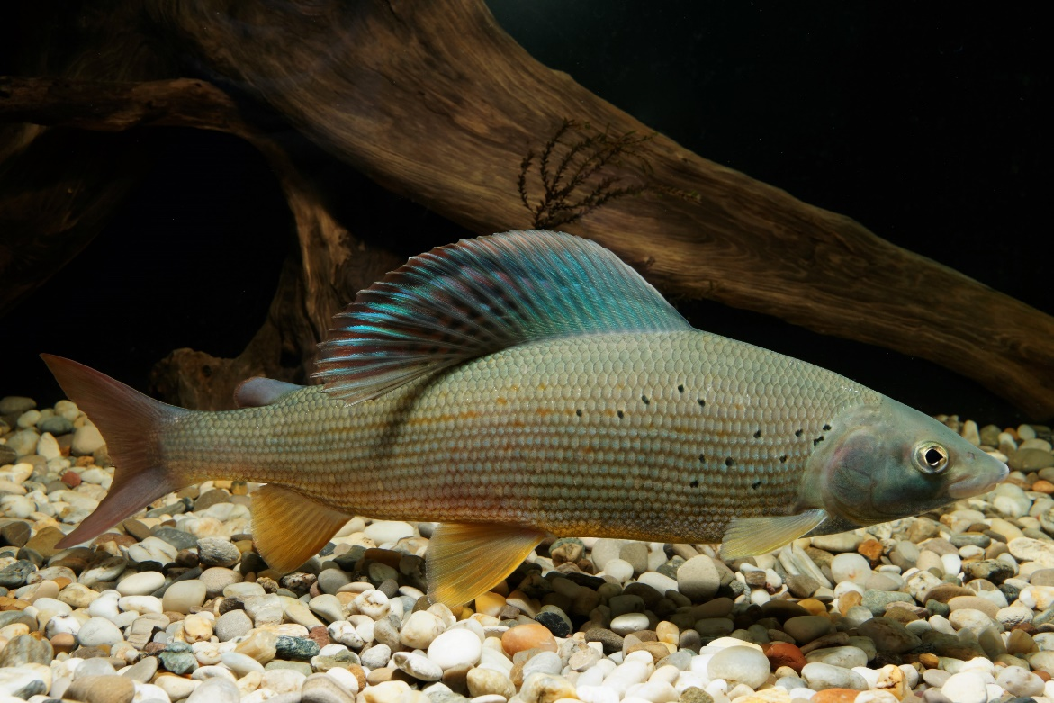
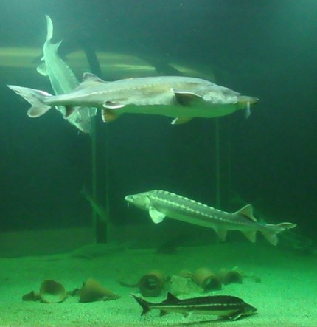
Examples of national priorities for non-deterioration or recovery of Annex V fish species
European Grayling
Assessed U1 - / U2 - (Unfavourable and declining)
in 23 national biogeographical region assessments (Art. 17)
Danube sturgeon (5 species)
Assessed U1- / U2- / XX (Unfavourable and declining or unknown) in 30 national biogeographical region assessments (Art. 17)
Copyright: Clemens Ratschan
Copyright: David Stanley / Fickr
(Danube River Sturgeon | Danube River sturgeon are on display… | Flickr)

Slide 16
Thank you for your attention !

