Slide 1

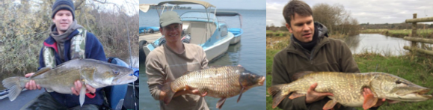
Recreational anglers as protectors and restorers of biodiversity
Professor Robert Britton
Director, Research Cluster in Fish Ecology, Bournemouth University, UK
rbritton@bournemouth.ac.uk
@FishEcol_BU

Slide 2
Recreational anglers as drivers of biodiversity protection & restoration
Introduction

Slide 3
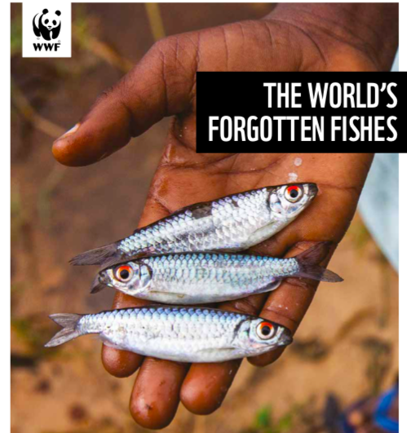
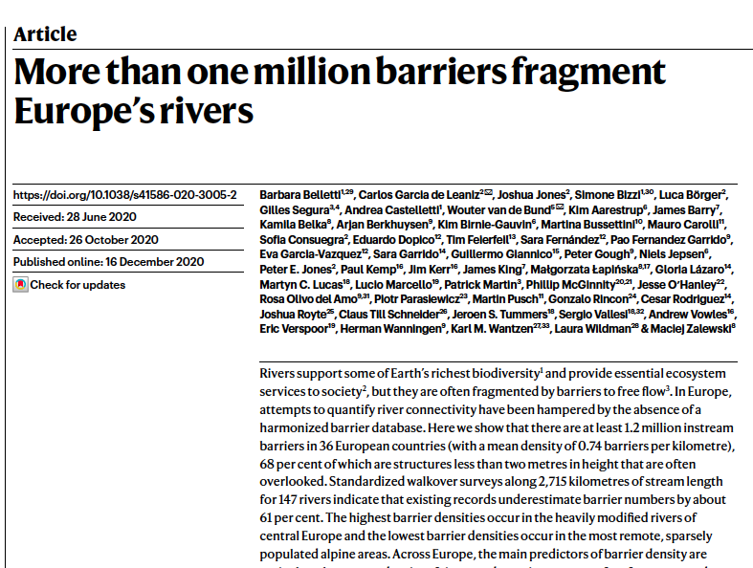
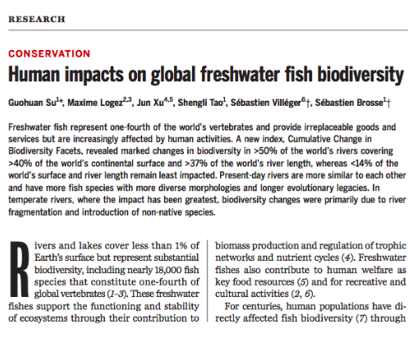
Issue
- 25 % vertebrates in habitats <1% of Earth surface
>30 % threatened with extinction/ > 80 already extinct
- Main drivers: River fragmentation & alien species

Slide 4
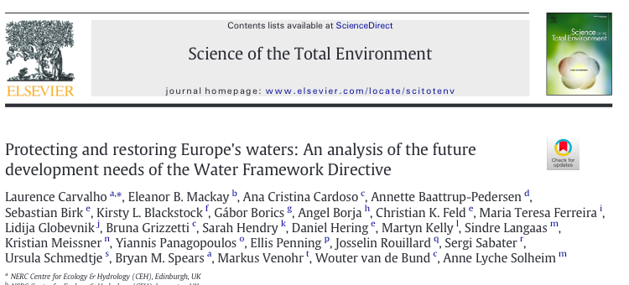
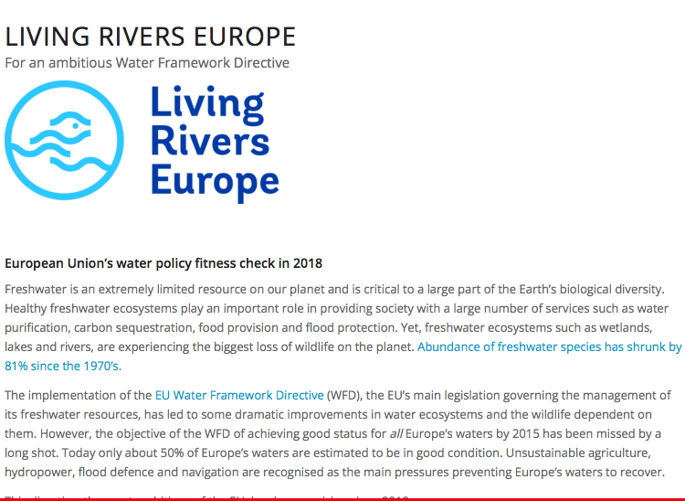
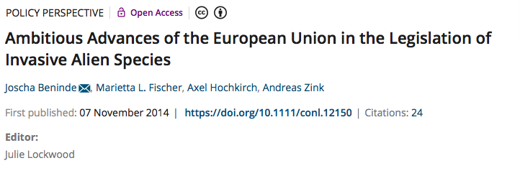
Resolving fish diversity loss can be assisted by strong legislation & policy…….

Slide 5
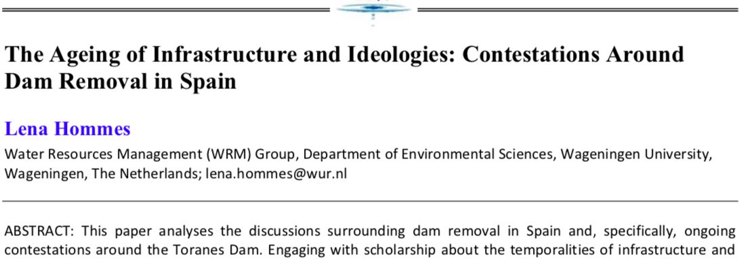
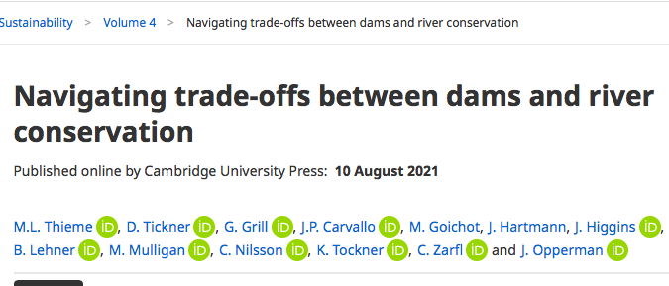
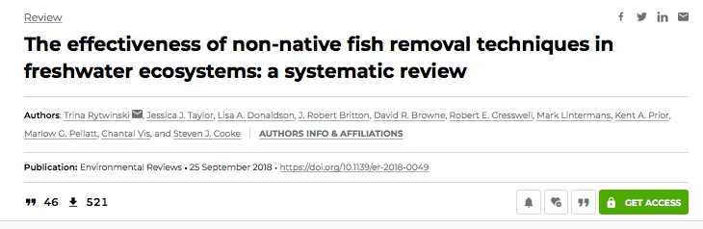
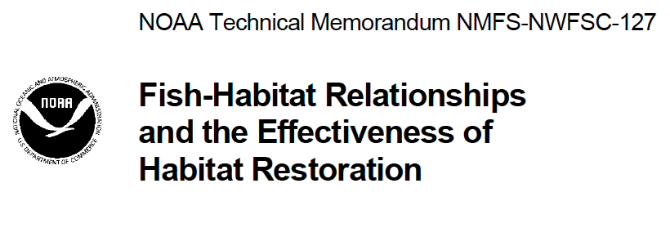
……and conservation management…..

Slide 6
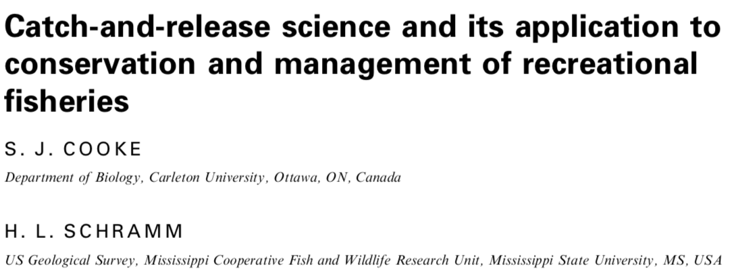
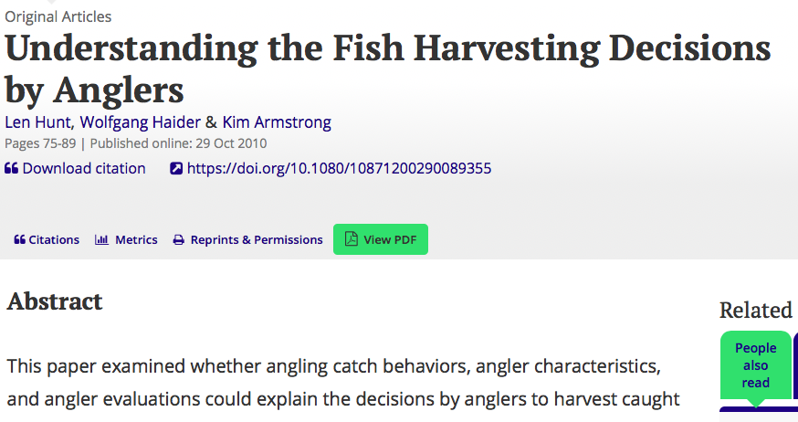
….and shifts in practices
All based on strong evidence based science

Slide 7
Recreational anglers as drivers of biodiversity protection & restoration
2. Angling & aquatic biodiversity

Slide 8
High angling participation….
At least 10% of the global population exploit fish recreationally
Europe: >16 million participants (as high as 24 million)
Promotes human well-being & mental health through connecting people with nature
High socio-economic values/ strong contributor to rural economies

Slide 9
Angler influences on biodiversity

Slide 10
Angler influences on biodiversity

Slide 11
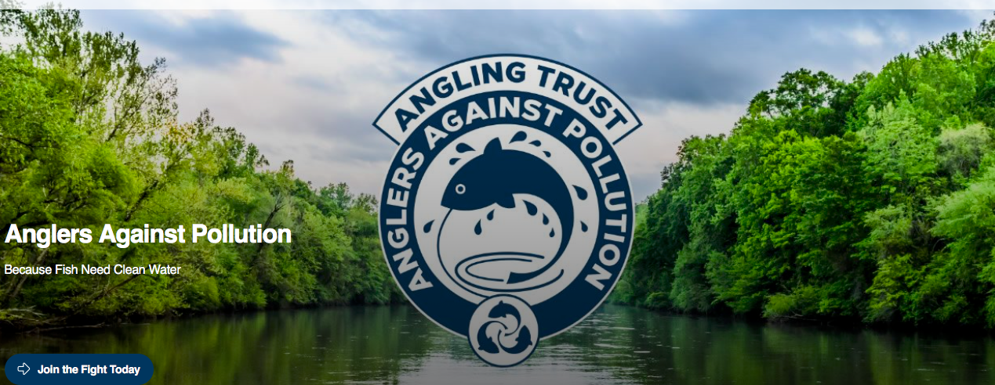
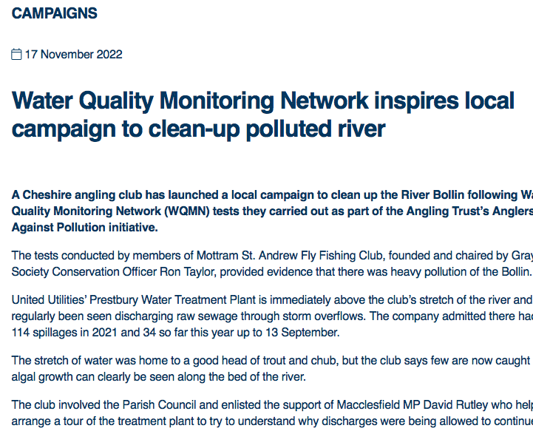
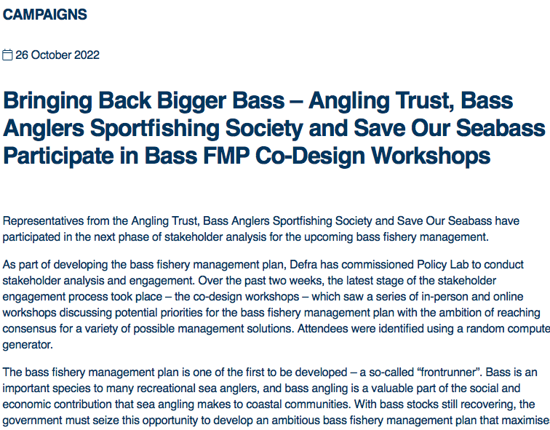

Slide 12
3. Examples of anglers as protectors & restorers of biodiversity

Slide 13
Anglers as protectors and restorers of biodiversity
Already heard today about nature protection & restoration schemes
To avoid repetition, my focus is on how angler practice & engagement can protect & restore biodiversity……

Slide 14
Anglers as protectors and restorers of biodiversity
Only time for three examples today:
Catch & release angling protects threatened species and their fisheries (practice change)
Contributing knowledge for data-poor species (contributing to evidence based science)
Angler river-fly monitoring initiative protects/ restores aquatic biodiversity (citizen science)

Slide 15
A. Catch & release angling
Captured fish returned alive/ any stress response is short-term
Good angling practices result in negligible mortality
Returned fish continue contributing to spawning stock
Adoption by anglers rapidly becomes a ’social norm’
Highly important for promoting population sustainability while maintaining fishery value

Slide 16
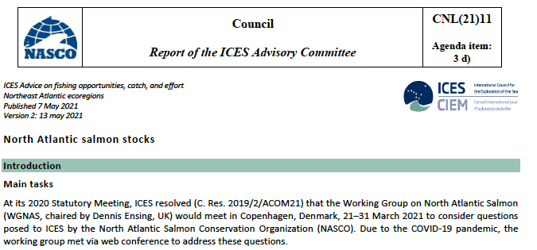
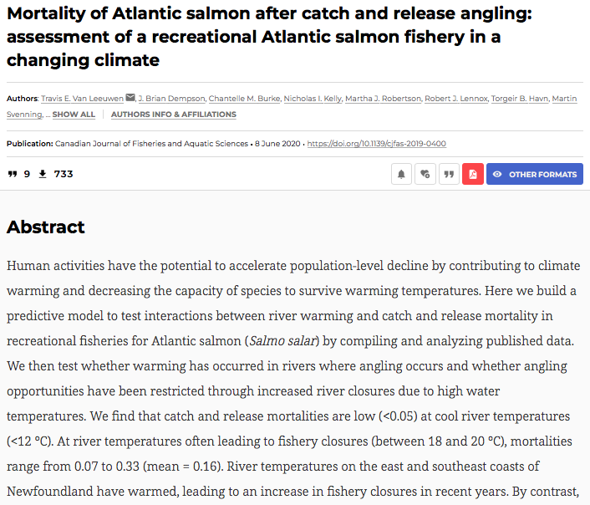
Atlantic salmon Salmo salar

Slide 17
Anglers as protectors and restorers of biodiversity
B. Contributing knowledge for data-poor species
Large freshwaters challenging for stock assessment
Results in data-poor species/ lack of science-led policy

Slide 18
Angler catch data preventing extinctions

Slide 19
Angler catch data preventing extinctions
2013:
Species undescribed to science
No data on population size/ trends

Slide 20
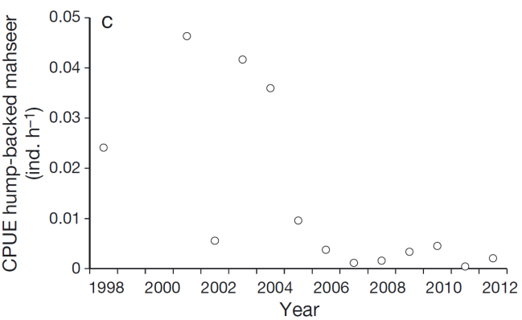
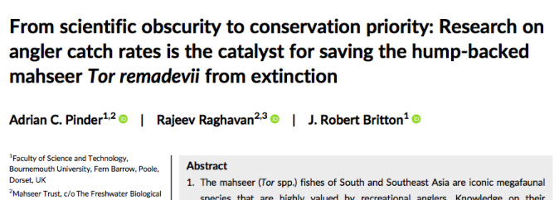
Angler catch data preventing extinctions
We sourced catch data from angling camps…..
….starting point that lead to their CE Red listing assessment in 2019

Slide 21
Anglers as protectors and restorers of biodiversity
C. Angler river-fly monitoring
Anglers are the ultimate citizen scientists
Eyes & ears of water-side
Passionate about natural resources
Has been harnessed for the benefit of biodiversity…..

Slide 22
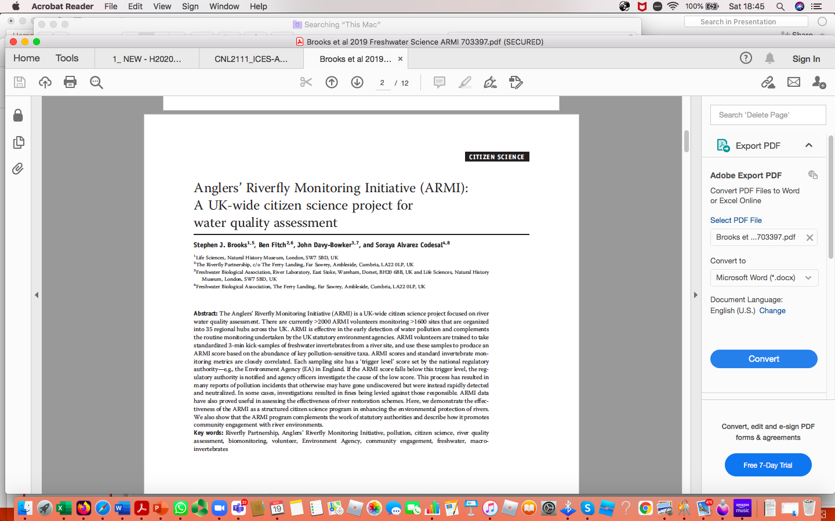
> 2000 volunteers monitor biological water quality in > 1600 sites
Early detection of water pollution/ complements statutory assessments
Assisted in prosecutions/ fines supporting restoration

Slide 23
Producing reliable and replicable data
In-kind value:
approx. 500,000 Euro p.a.

Slide 24
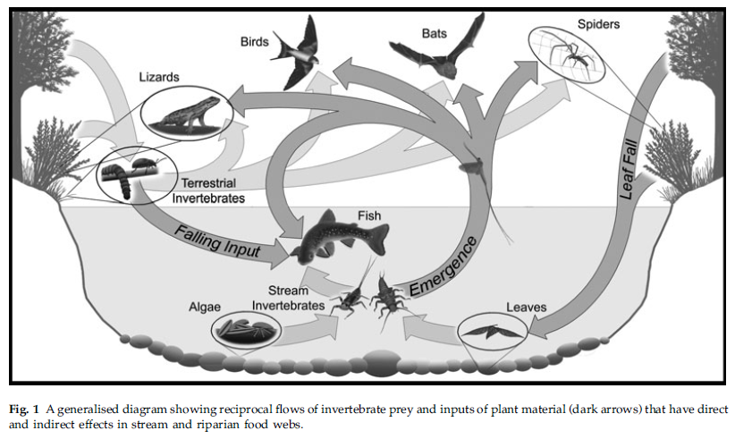
With wide benefits to biodiversity

Slide 25
Recreational anglers as drivers of biodiversity protection & restoration
4. Conclusions

Slide 26
4. Conclusions
Angling/ anglers play fundamental roles in protecting & restoring biodiversity
C&R, data provision, citizen science (+ funding R&D, habitat restoration etc. etc.)
Direct contributions to meeting/ implementing WFD, IAS Regulations, CFP reforms
While also promoting human well-being/ mental health: connecting people with nature

