Slide 1
Migration Corridors for Sturgeons - Breaking the Silos
Peter Gammeltoft
Danube Sturgeon Task Force
Chairman

Slide 2
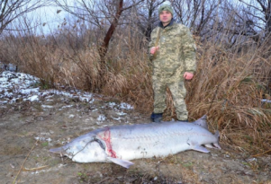
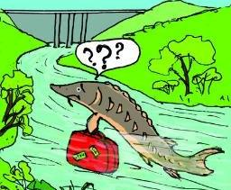
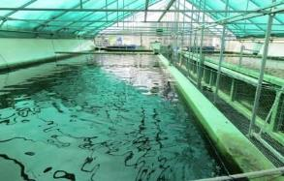
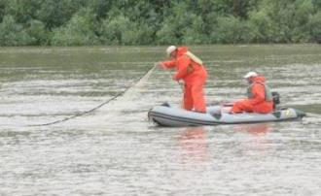
MAIN PRIORITIES FOR STURGEONS
Prevention of poaching or by-catch of wild sturgeons in fresh and marine waters
Restore and maintain ecological migration corridors and habitats, including removal of obstacles to migration
Establishment and operation of conservation hatcheries and restocking of sturgeons in the Danube
Establishment of an effective system for sturgeon population monitoring

Slide 3
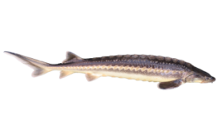
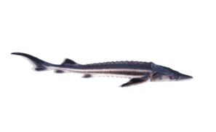
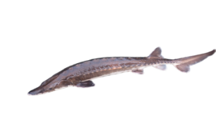
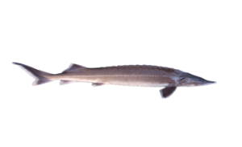
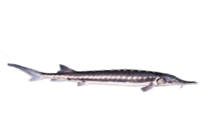
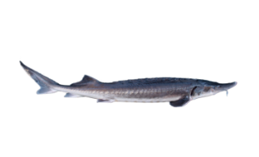
New IUCN Red List Assesment July 2022: - No time to lose in Europe ….But only potected by HD Annex V
Russian Sturgeon | Adriatic Sturgeon | Ship Sturgeon | Atlantic or Baltic Sturgeon
Sterlet | Stellate Sturgeon | European/Common Sturgeon | Beluga
CR
CR
CR EXTINCT in the Danube & extinct in the EU
CR
EN
CR
CR
EXTINCT in the Danube
CR
© M. Roggo f. A. sturio; © Thomas Friedrich

Slide 4
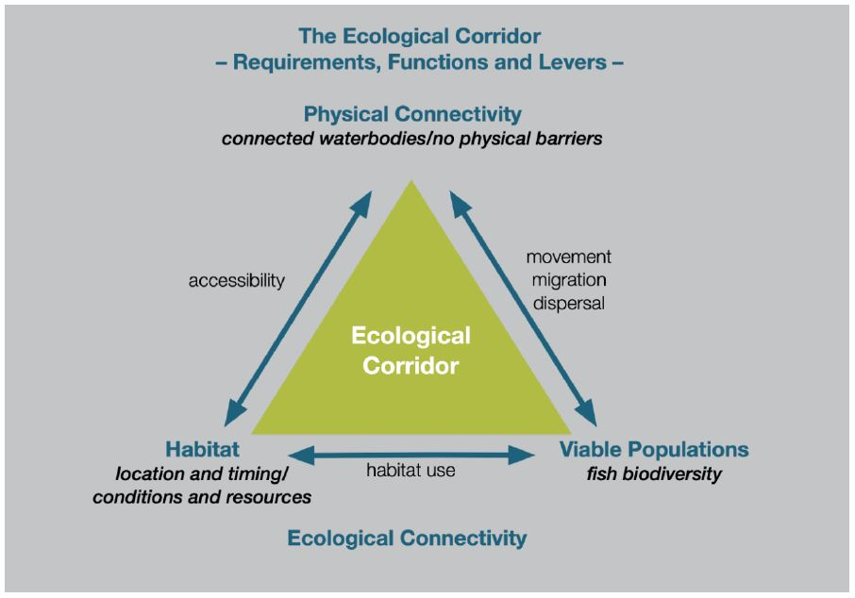
https://www.interreg-danube.eu/approved-projects/measures

Slide 5
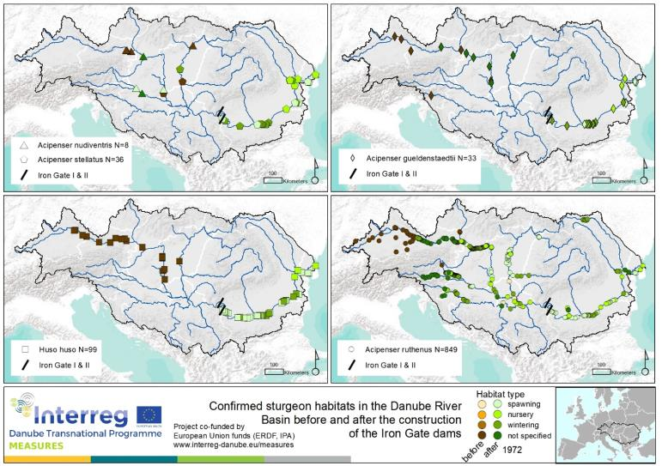
Mapping of habitats of sturgeons
Available data was collected to map sturgeon habitats (spawning, nursing, wintering, not specified)
Not a complete picture needs additions
Not a picture of the distrubitions of the species
Best basis available → Integrated in Danube RBMP 2021

Slide 6
https://www.interreg-danube.eu/approved-projects/measures

Slide 7
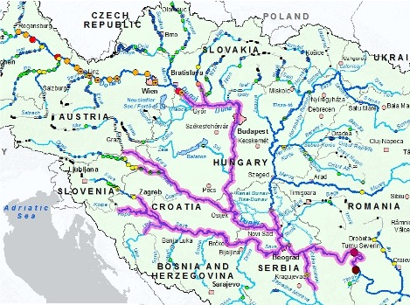
Once Iron Gates become passable
the access to free flowing river stretch will double the current stretch of the Lower Danube.
several countries will need to share the responsibility of an Ecological Corridor management for migratory sturgeon – no new obstacles!
Desiging and implementing functional fish passages at this scale needs time

Slide 8
https://www.interreg-danube.eu/approved-projects/measures

Slide 9
STURGEON POPULATION SUPPORT MEASURES in the Danube Basin
fishing bans in place throughout the basin (however, angling allowed in AT and SK).
But enforcement is weak ⇒ considerable poaching
A first ex-situ breeding facility for restocking will start operations shortly

Slide 10
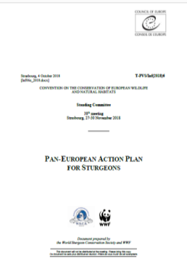
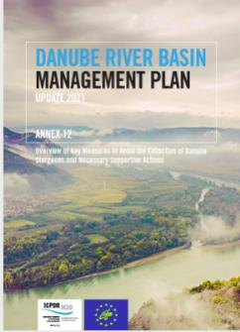
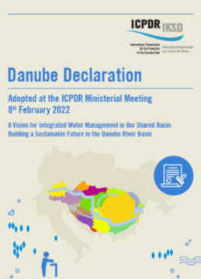
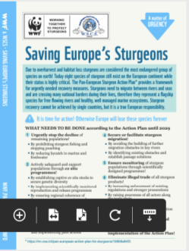
Pan European Action Plan – (PANEUAP) provides a framework on European level
Adopted by the Bern Convention (2018)
Endorsed as EU Species Action Plan under Habitats Directive (2019)
Support to the PANEUAP in ICPDR Ministerial declaration (2022), in ICPDR River Basin Management Plan and in EUSDR Biodiversity Component

Slide 11
IMPLEMENTATION DIAGNOSTIC - 1
HABITATS
No systematic identification & monitoring (marine/fresh waters)
Very little restoration/management of habitats
No systematic planning for habitats
PHYSICAL CONNECTIVITY
Monitored by ICPDR
ICPDR and Danube States are implementing a long-term plan for removal/mitigation of obstacles to fish migration
POPULATION SUPPORT
Enforcement of fishing bans must be strengthened
Coherent basin-wide population monitoring is urgently needed
More ex-situ breed and restock facilities needed

Slide 12
IMPLEMENTATION DIAGNOSTIC - 2
Absence of effective protection under Habitats Directive (Annex V only)
Lack of national implementation plans, following the PANEUAP.
Absence of coordination between inland and marine management
Absence of basin-wide coordination and a forum for coordination of habitats and population issues
Absence of exchange of information (except for physical connectivity)
Absence of coordination between water and nature management at national and basin levels
Absence of national and basin wide population monitoring to inform decisions

Slide 13
NRL PROPOSAL - STURGEON LITMUS TEST for Long-Distance Migratory Fish (e.g. sturgeon)
The NRL proposal is a very welcome and long overdue proposal to strengthen biodiversity with many important elements
BUT does little for long distance migratory fish
by not breaking up silos and promoting cooperation
between land and marine
between countries, and
between authorities within countries
by not compensating for lack of protection under HD – in spite of IUCN Red List
by not promoting coherent population monitoring to improve decision making
AND confounds issues by treating connectivity as an end in itself rather than a means to an end (i.e. to provide for migration across jurisdictions and ultimately biodiversity)

Slide 14
Thank you for your attention !
IF WE DON’T ACT NOW,
WE WILL LOSE MORE STURGEON SPECIES !
www.dstf.info
info@dtsf.info

