Slide 1
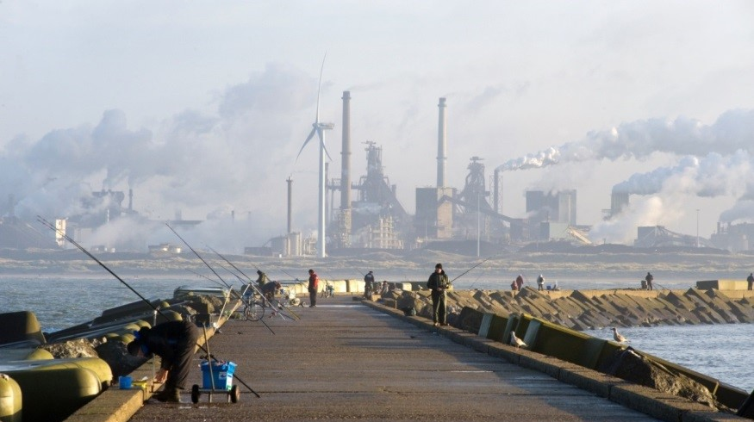
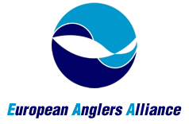
State of play of recreational fisheries in the EU
An anglers perspective
David Vertegaal | 25 January 2018
RecFish Forum, European Parliament, Brussels, January 25th 2018
Notes:
The picture I chose
The picture in the background illustrates how anglers are motivated to fish if fish are present – no matter what.
This one location attracts 10.000 anglers each year. Anglers spend 1,2 million €/y in this coastal community alone.
Background document by Hyder et al, for the PECH committee
‘Marine recreational and semi-subsistence fishing – its value and its impact on fish stocks’

Slide 2

Marine recreational fisheries – what is it ?
  ‘The capture or attempted capture of living aquatic resources, mainly for leisure and/or personal consumption. This covers active fishing methods including line, spear, and hand gathering and passive fishing methods including nets, traps, pots, and set–lines.’ (ICES)
  8,7 million people fishing at sea recreationally
  100.000 jobs (FTE) and 10,5 billion revenue for Europe
  if MRF were one company it would be one of Europe’s top 10 companies
Notes:
Link between sector size, effort and stock size/management
There is a direct link between fish stock abundance and health, access to fishing opportunities and recreational fishing participation rates and the resulting employment and economic impacts it delivers.

Slide 3
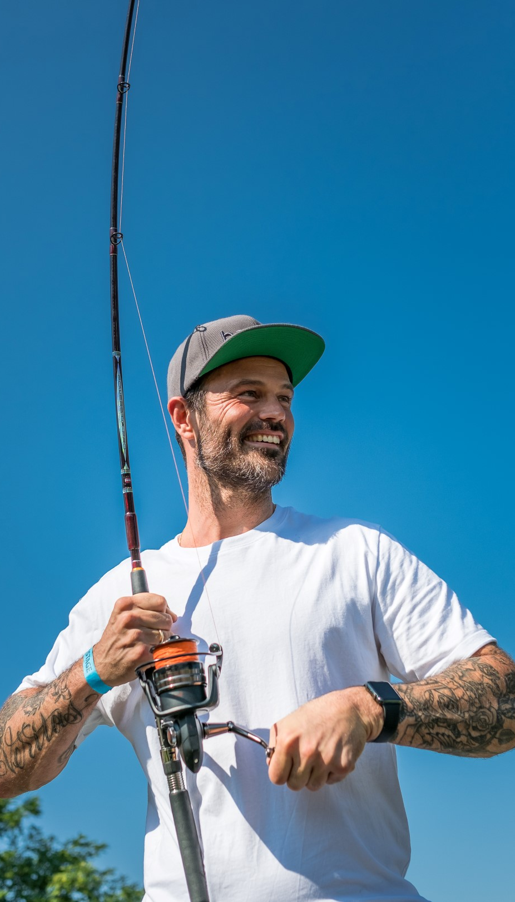
1. MRF impact – data collection
  Data collection on the MRF sector is lacking
  Mandatory for member states since 2002
  MRF impacts vary with stock from limited to significant
  Managing in the dark - the sea bass case
Notes:
I’d like now to share the main findings of the Nicolai report with you.
Lacking data
In the past, MRF sector importance and impact has not (completely) been taken into consideration in stock assessments and allocation decisions.
In past discussions the parliament has made it crystal clear this is a big thing. MEP Nicolai stresses in her report that the multiannual plans might not achieve the objectives of the CFP if reliable MRF data is not properly integrated.
Mandatory data collection
Under the Data Collection Framework (2001), annual estimates of catch and release are required for the 5 species cod, sea bass, eel, bluefin tuna and salmon, plus all elasmobranch species.
The Control Regulation (2009) specifies that recreational catches of stocks subject to recovery plans (e.g. TAC’s) must be monitored.
Sea bass case
(not extensively presented due to time constraints)
For the 2018 fishing opportunities, only recent data from UK and The Nl’s were available for analysis and have been used for extrapolation for other countries.
As a result, after 2 years of strict management measures (MCRS increased from 36 to 42 cm, half year closed seasons, bag limit of one/p/d for 2016 and 2017), MRF mortality for sea bass went up from 2012 (the year with the 3rd highest sea bass SSB stock in recorded history) to 2016 (when SSB was already below Blim).
A reduction in the 70-80 % region was expected....
To say this outcome is counter-intuitive would be putting it mildly.

Slide 4
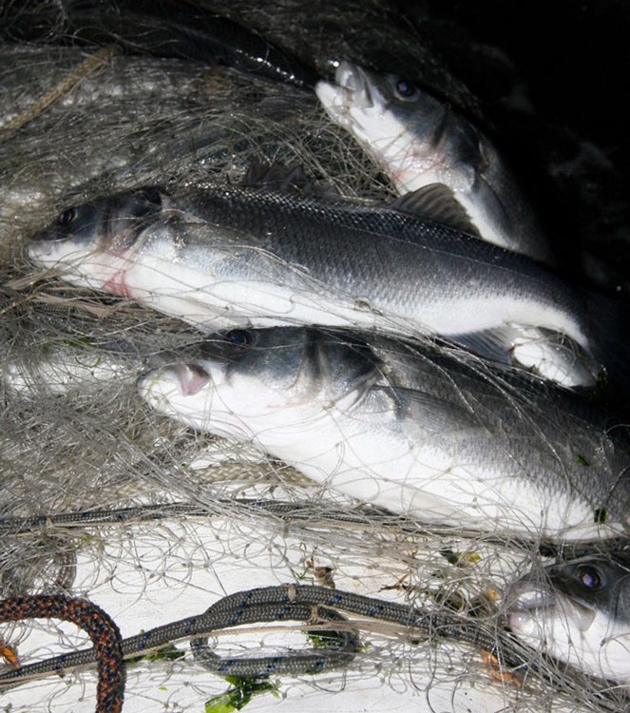
2. Semi-subsistence fisheries (SSF)
  Hardly registered catches
  Sales of fish
    Illegal and legal practices
    Exemptions exemptions
    Significant impact: 3 times official sea bass landings (UK)
  SSF is currently not being managed
    CFP free riders
    SSF management: part of the MRF management effort
    Sales = commercial activity
Notes:
Semi-subsistence fisheries – what is it ?
Semi-subsistence fisheries: small proportion of income is derived from catch sales, (part) of the catch may be used to feed family and/or friends.
Picture
MRF recreational fishermen with nets – can’t land in 2018, will fish and kill without further measures.
Exemptions or fully documented fisheries? (not presented)
Article 14 - Completion and submission of the fishing logbook - exemption: “only catches > 50kg/species”.
Article 16 - Fishing vessels not subject to fishing logbook requirements.
Article 21 - Completion and submission of the transhipment declaration – exemption: “only catches >50kg/species”.
Article 25 - Vessels not subject to landing declaration requirements.
Article 56 - Principles for the control of marketing – exemption: “own consumption < 30 kg”.
Article 59 - First sale of fisheries products – exemption: “own consumption < 30 kg”.
Article 65 - Exemptions from sales notes requirements – exemption: “own consumption’ < 30 kg + the 50 kg rule
SSF transparency
CFP free riders - tax free too
CFP only distinguishes 2 categories: Commercial and recreational
For both commercial and recreational groups to work together successfully under the future CFP, the issue of the semi-subsistence fisheries needs to be resolved so that all commercial activities are registered, transparent and legal. This will require a serious effort on the part of the member countries.
If you want everybody but SSF to adhere to the CFP regulations, you would need to have some very compelling reasons for that to be accepted by the other players. It would erode their willingness to comply to the CFP.

Slide 5

Conclusions MEP Nicolai
  MRF must become fully integrated in the CFP
  SSF must be transparently managed as either commercial (sales) or recreational activity
Notes:
CFP integration
For reasons of social and economic relevance and (stock) impacts.
SSF
We believe that management efforts should reflect the ambitions of the policies they are meant to uphold.

Slide 6
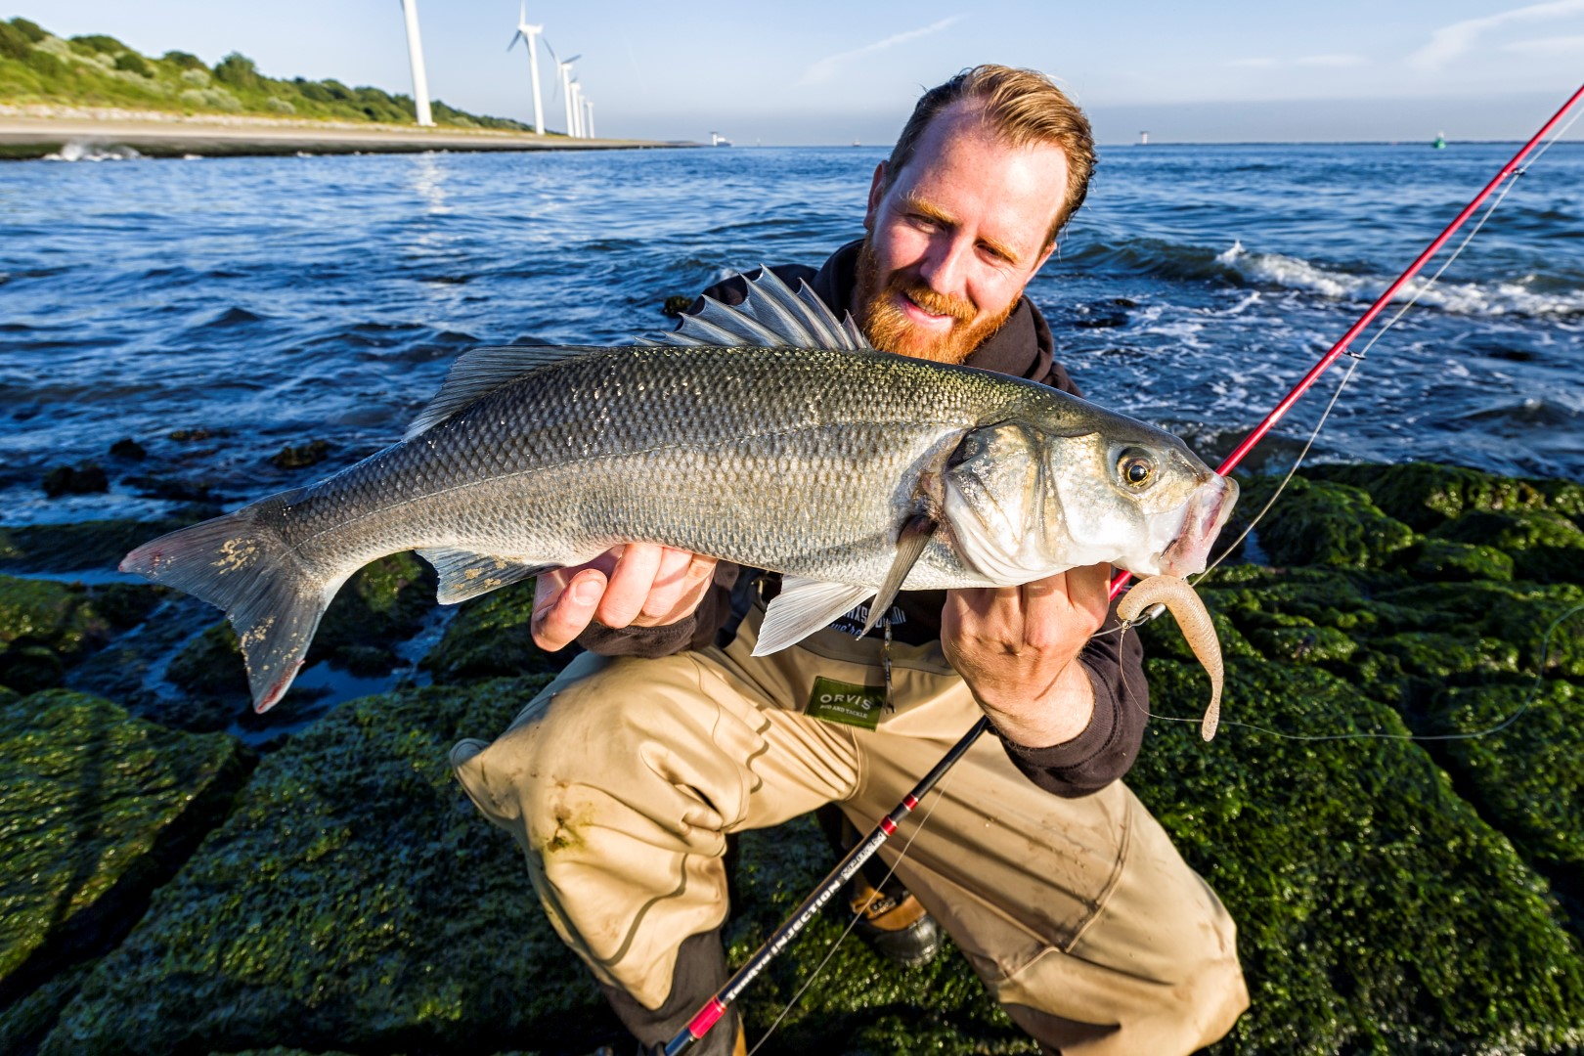
CFP and MRF

Slide 7
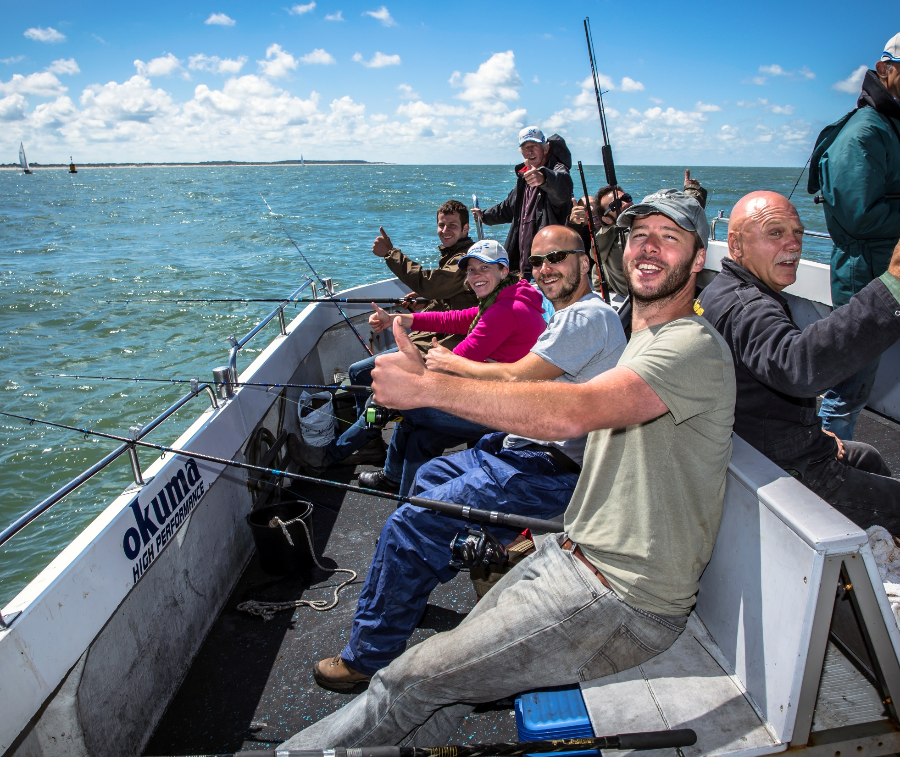
CFP goals at a glance
  CFP goals
    Manage fish stocks (common resource )
    Manage European fisheries
    Manage sustainably
  Sustainably, how ?
    socially, economically and environmentally
    maximize catches
    reduce bycatch and discards
Notes:
Maximize catches
Maximize catches without crashing the stocks seeks to optimize economy and environment.
We believe all socio-economic and environmental aspects should be weighed in this.
A higher selectivity and lower bycatch could do a lot to offer a more fruitful situation for MRF and small scale fishermen in this respect.

Slide 8
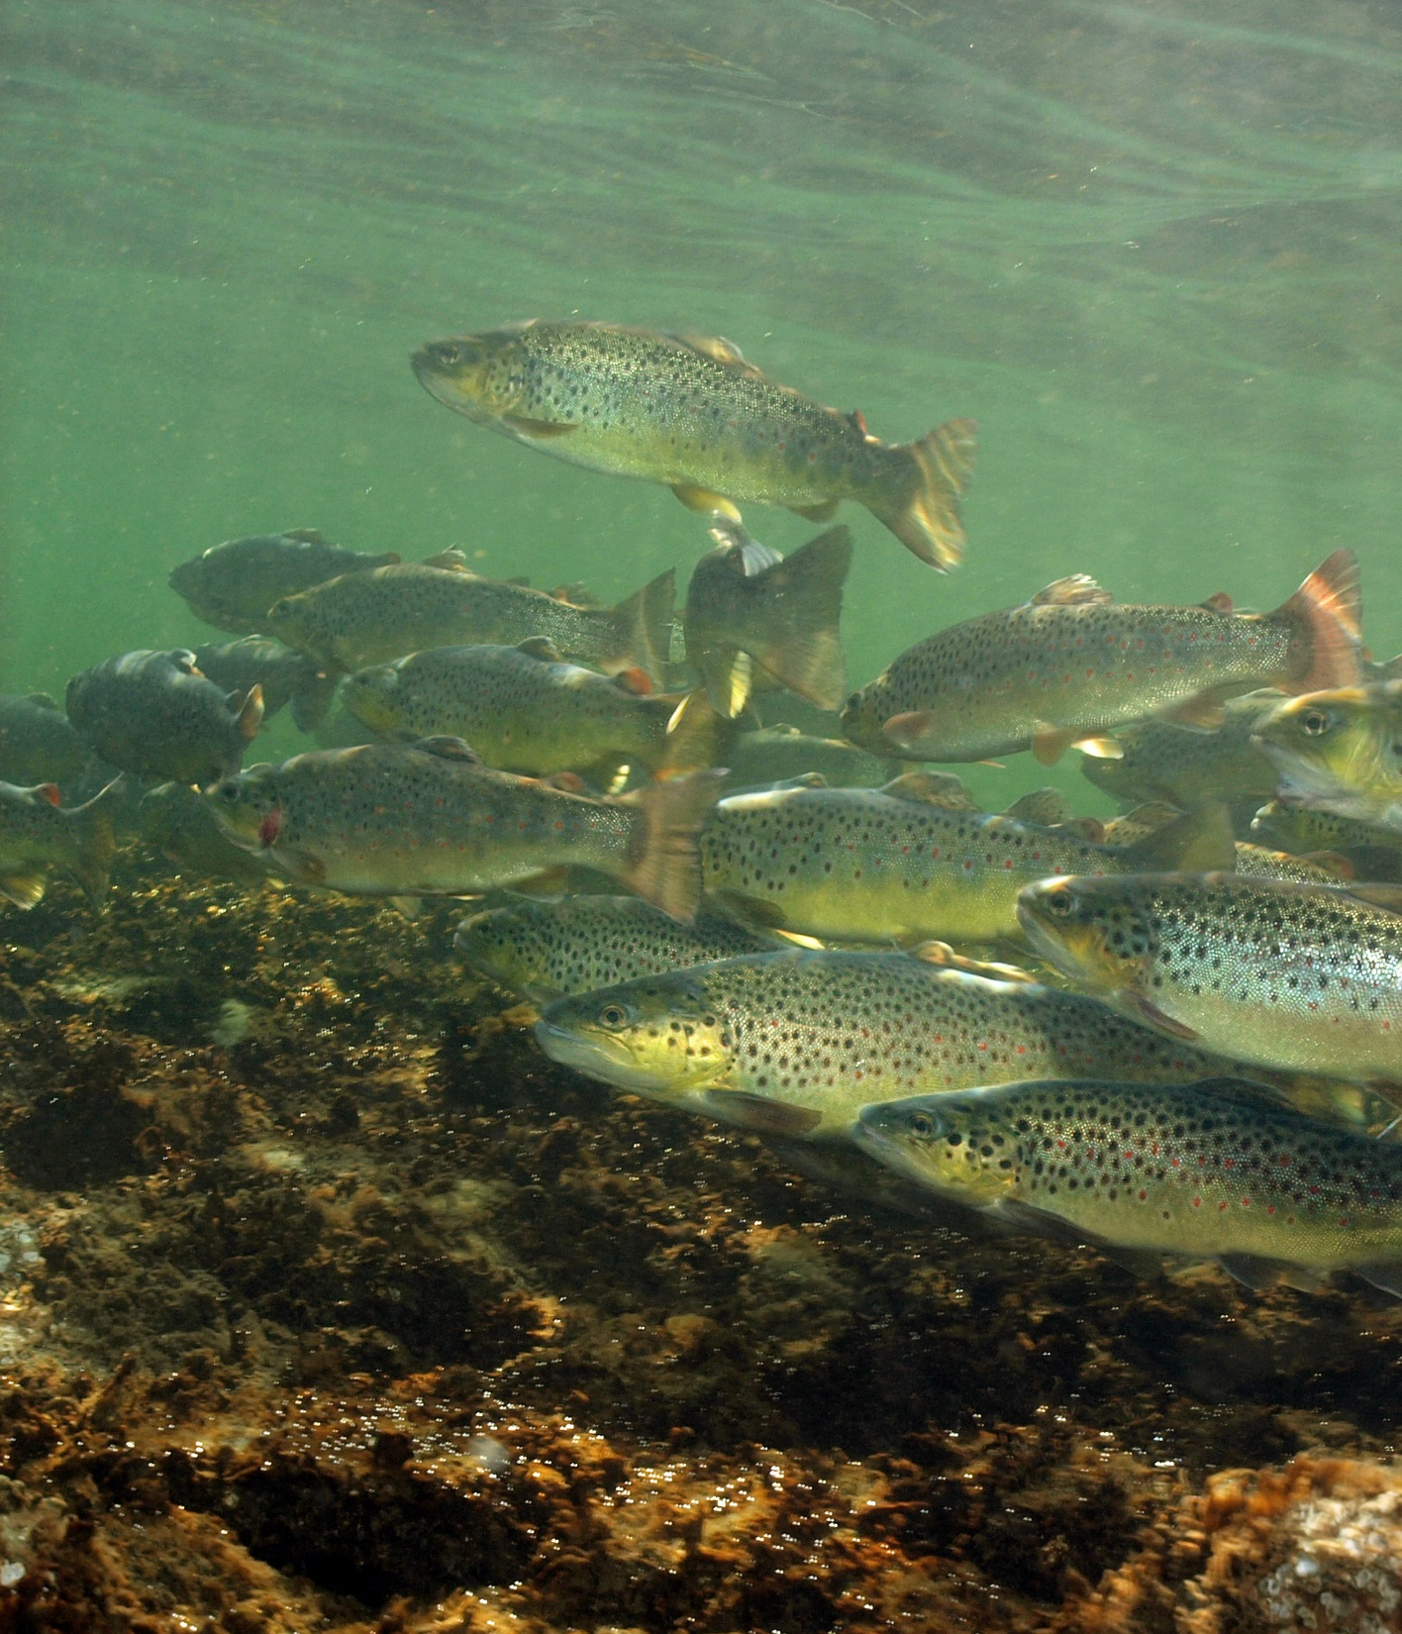
CFP and sustainable use – on track ?
  Maximum sustainable yield by 2020 (MSY)
  Stock recovery mostly on schedule
    For the big commercial, intensively managed stocks
    Not so for none-to-less commercial stocks
  Such ‘secondary stocks’ suffer from
    Low management priority
    Bycatch, discards
  For CFP reform, MSY reinterpretation is needed
    Reaffirmation of the current CFP philosophy
    ‘Yield’ = ∑ (economy, social & environment)
Notes:
Secondary stocks are
Diadromous migratory species e.g. salmonids, eel, shad, sturgeon
Sharks and rays
Sea bass – dubbed ‘the most spectacular failure of the CFP’. Also: very valuable to both MRF and small scale fisheries.
From the Nicolai report:
Additional measures are needed to expand data collection for recreational fisheries to encompass more fish stocks and to make the collection of data on its socio-economic impact mandatory.

Slide 9
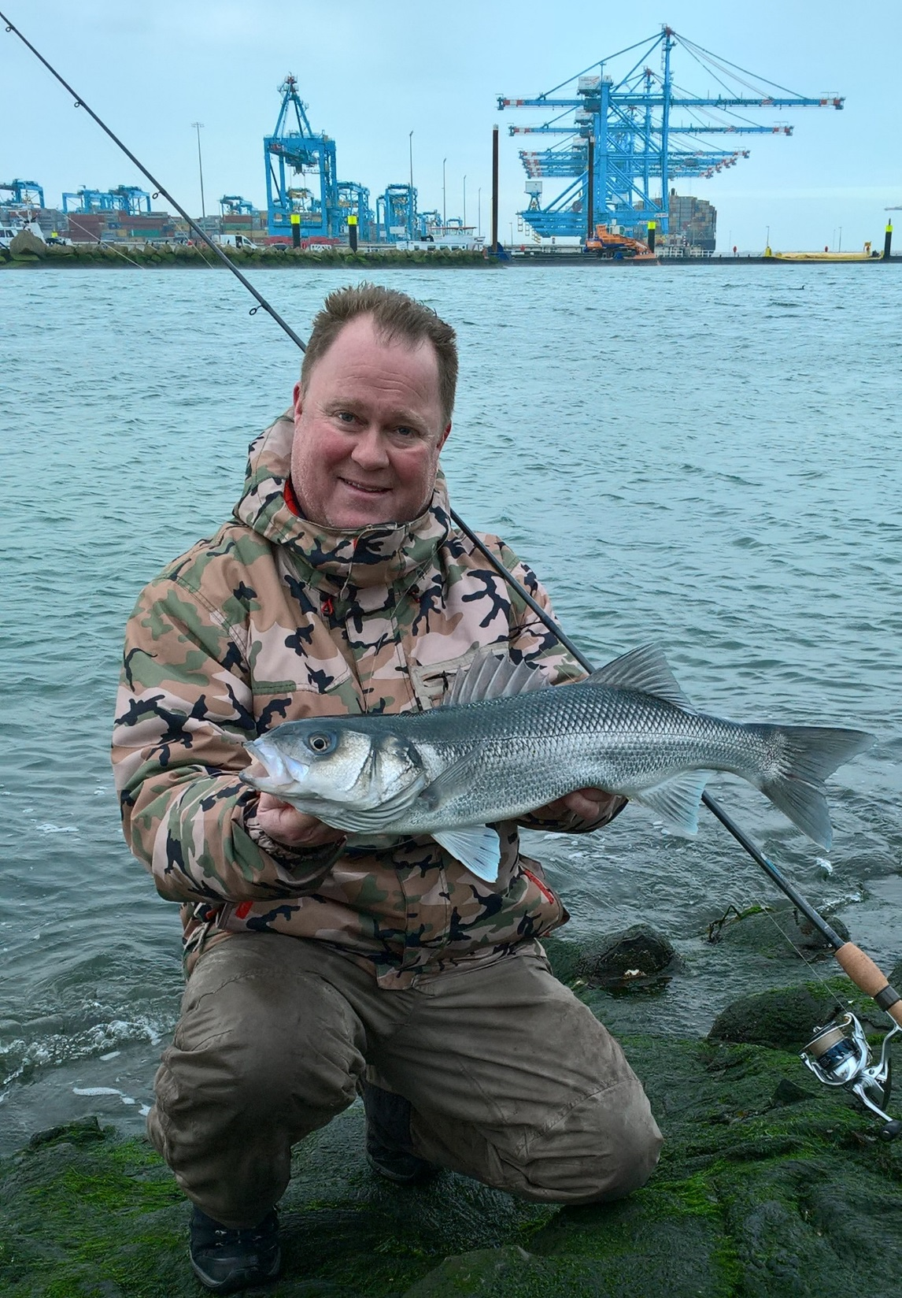
MRF in the CFP
  Earlier proposals blocked by the Council in 2013
  Will MRF in the CFP frustrate commercial stakes ?
    Large scale fleet
    Not so much (commercial stocks)
    Landing obligation will improve bycatch
    – with or without MRF in the CFP
    Small scale fleet
    ‘close contact’ with MRF - we share stocks e.g. sea bass, mullet
    To increase sustainability of these stocks, we need to work together
    A thriving MRF sector will give a boost to coastal communities
    And do so within the framework of the CFP !

Slide 10
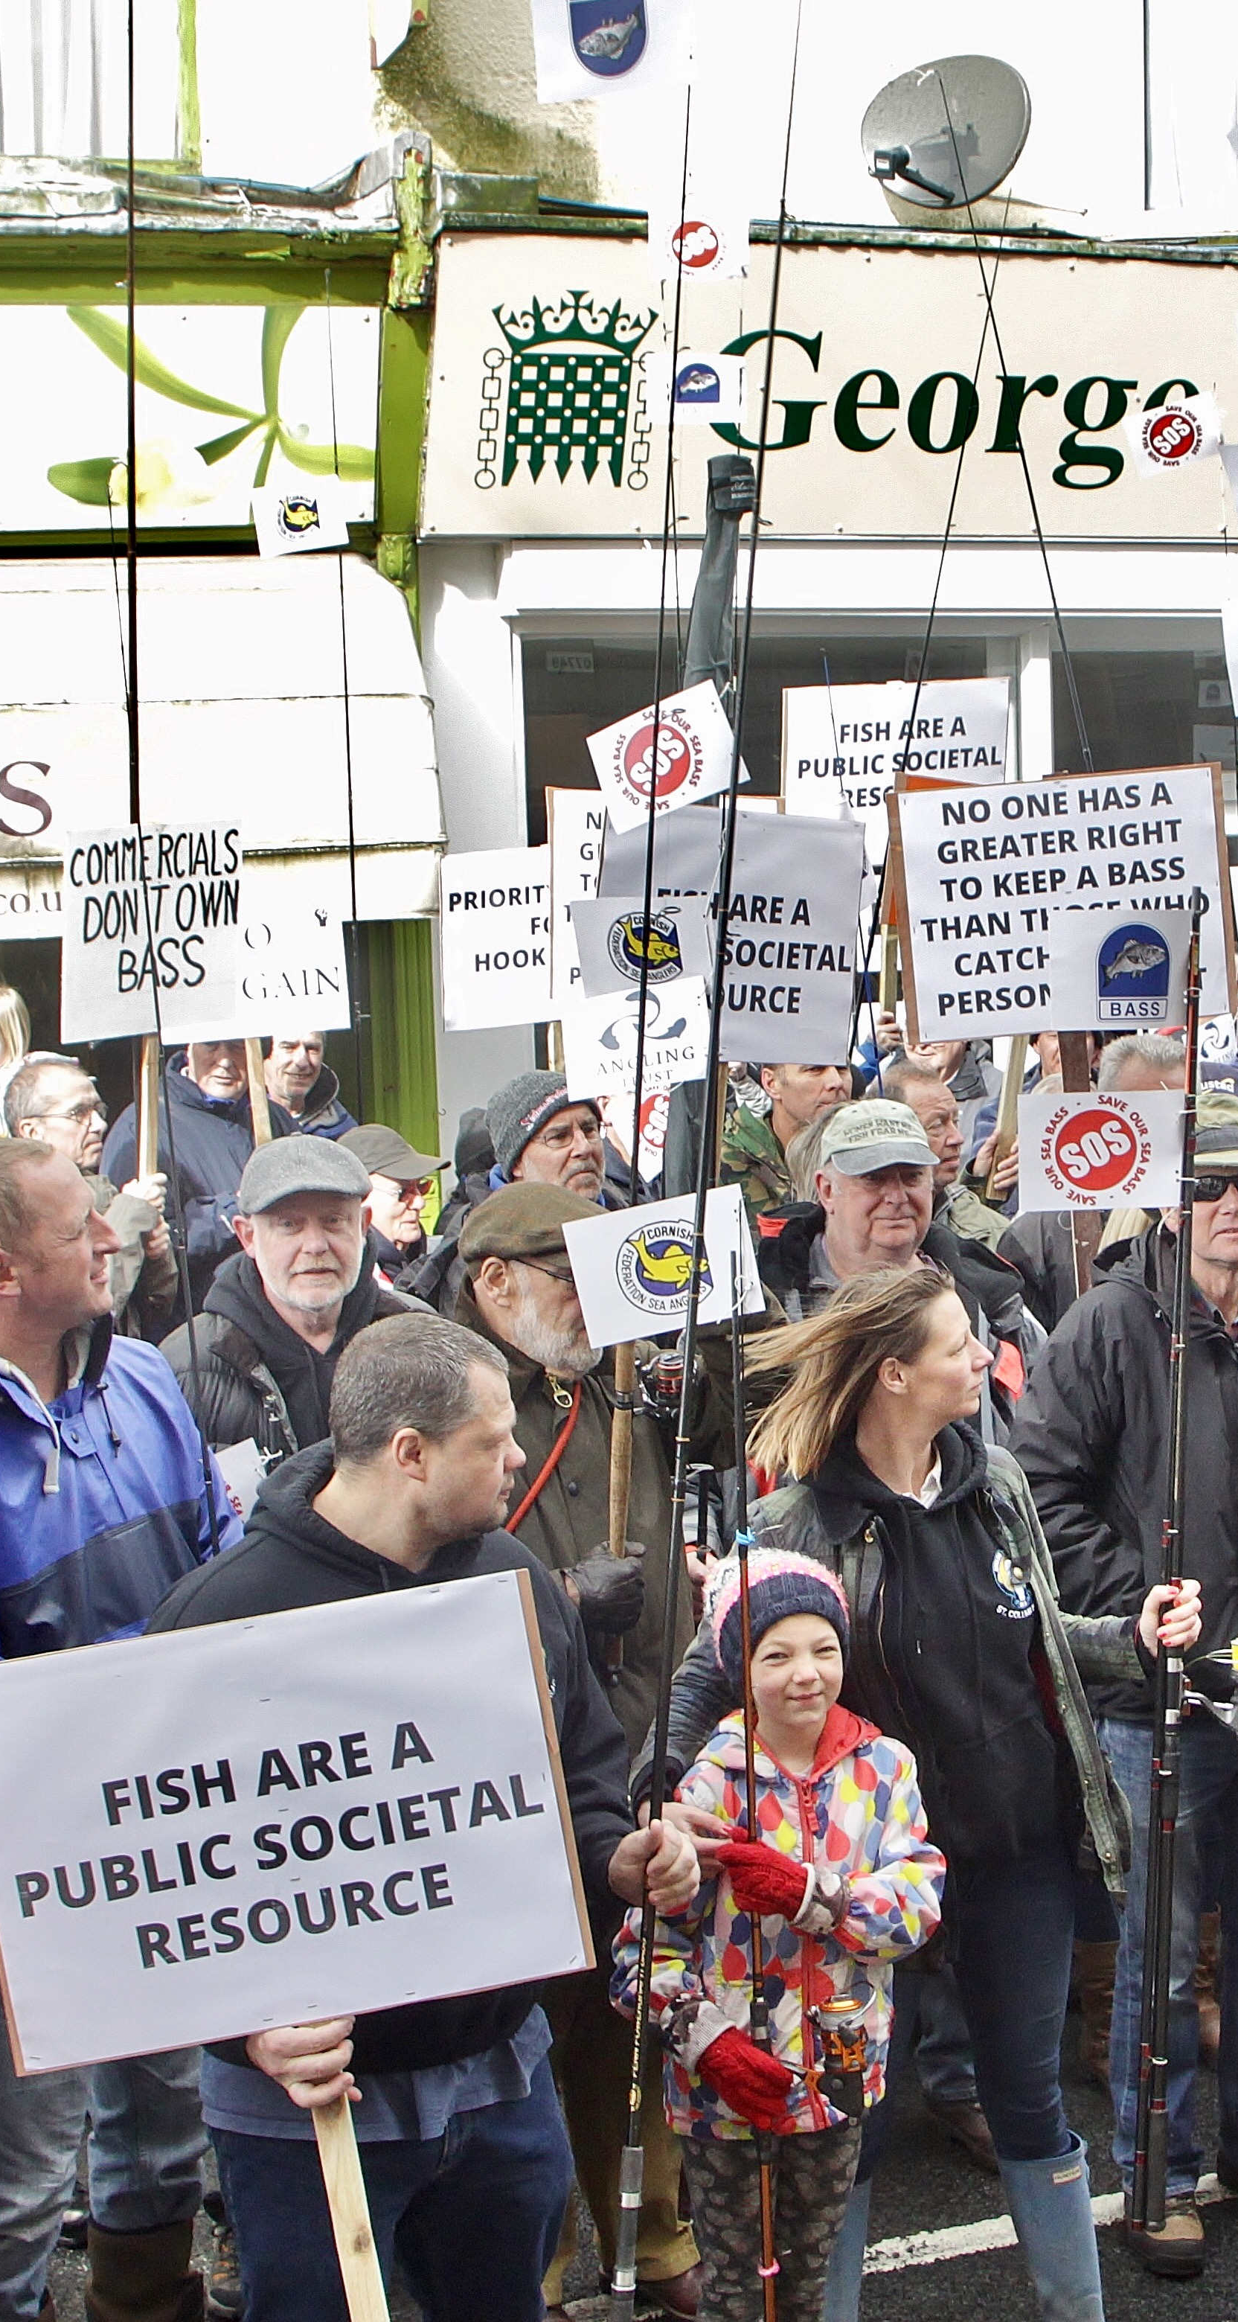
Conclusions – MRF in the CFP or …. ?
  MRF and the commercial sector need to work together
  to achieve the best outcome for all concerned
  MRF is an important stakeholder
  Fish stocks are a public resource
    MRF represents 9 million European stakeholders
  So we need to do all this from within the CFP framework, together
Notes:
MRF is an important stakeholder
- Impact
- Socio-economics
- New opportunities for coastal communities – let’s see these opportunities

Slide 11

Thank you for your participation
A member state without voting rights…
…. is like the CFP without MRF.
So let’s include MRF in the CFP !!

